Slide 1
Liquid Displacement Using Mentos
Presented by:
Jacob Haussler, James Hawkins, Nzube Ohalete, Pragya Khanal

Slide 2
Initial Proposal
Goal - To see how much liquid is displaced
3 factors, 2 levels, 2 replications
16 runs, 80 minutes
Details on how the experiment will run
Calculation of weights of liquid displaced
Randomization of experiment and calculation of power

Slide 3
Changes in the resubmitted proposal
Original
Resubmission
2 replications
16 runs, 80 minutes
Type of soda = Coke and Fanta
Level of mentos (2,5)
Temperature = Refrigerated and Room Temperature
No role assignments
3 replications
24 runs, 120 minutes
Type of soda = Coke and Diet Coke
Levels of mentos (2,4)
Temperature = Refrigerated and non-refrigerated
Role assignments
More details

Slide 4
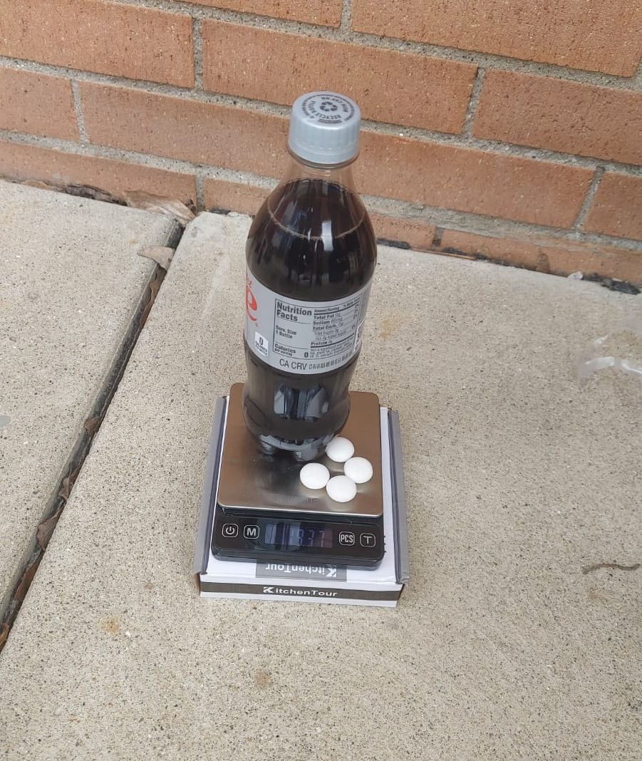
Actual Experiment Implementation
3:20PM-Weather problems
3:30PM-An Idea
3:45PM-Hope
3:50PM-The Set up.
4:00PM-First Soda explosion
5:00PM-Half-way through
5:40PM- The clean up

Slide 5
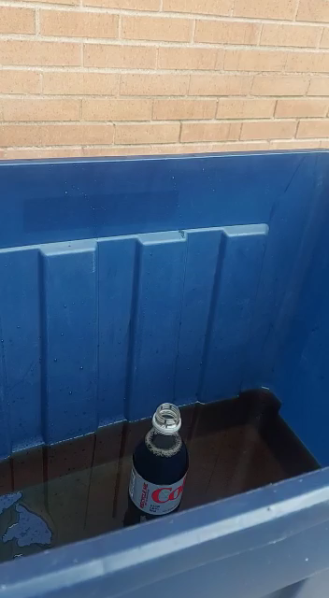
Surprises

Slide 6
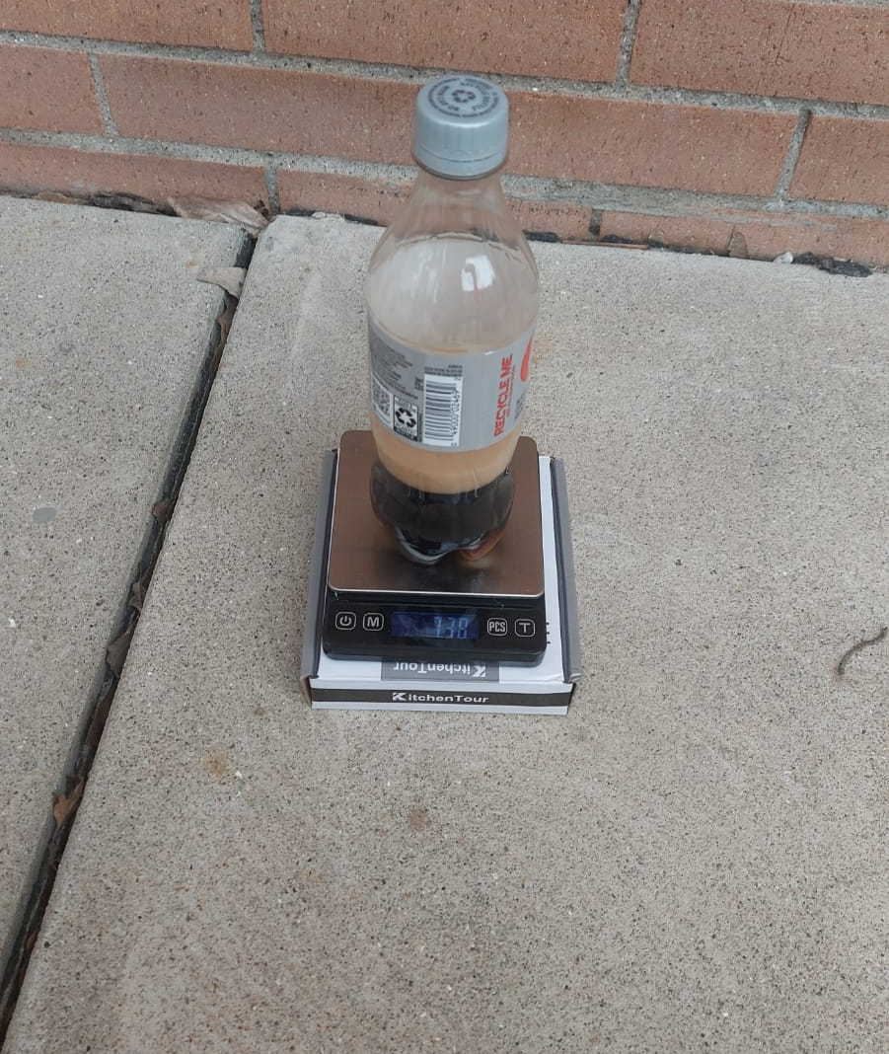
Surprises cont.
Soda explosion size
Drop method
Weather
Cola vs Diet

Slide 7
ANOVA Table
 | Df | Sum Sq | Mean Sq | F value | P-value
A | 1 | 3.721 | 3.721 | 35.698 | 1.94e-05
B | 1 | 17.906 | 17.906 | 171.783 | 5.67e-10
C | 1 | 18.079 | 18.079 | 173.445 | 5.29e-10
A:B | 1 | 0.003 | 0.003 | 0.029 | 0.86659
A:C | 1 | 0.053 | 0.053 | 0.510 | 0.48525
B:C | 1 | 1.576 | 1.576 | 15.119 | 0.00131
A:B:C | 1 | 0.000 | 0.000 | 0.000 | 0.99503
Residuals | 16 | 1.668 | 0.104

Slide 8
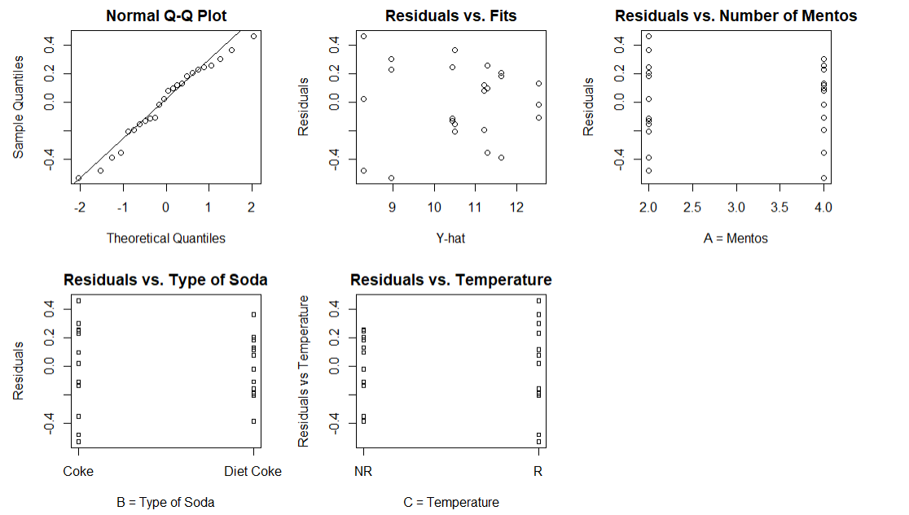
Assumptions Checking
Normality
Constant Variance (Homogeneity of Variance)

Slide 9
Pairwise Comparisons for A (Number of Mentos)
TukeyHSD(outthree, "A")
diff lwr upr p adj 4-2 0.7875 0.5080886 1.066911 1.94e-05
The mean liquid loss due to four mentos candies is significantly better than that of two mentos candies.

Slide 10
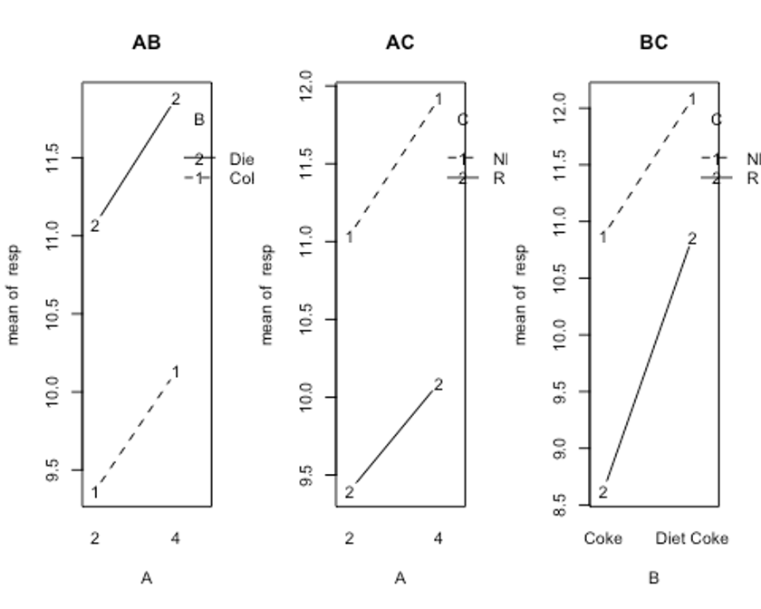
Two-factor Interaction Plots

Slide 11
Contrasts for B:C Interaction
The effect of B when C=Refrigerated minus the effect of B when C=Not Refrigerated
Point estimate = 1.0250000
95% Confidence interval = (0.4119246, 1.6380754)

Slide 12
The Best Set of Conditions
Using Scheffe:
Point estimate = 0.9033
95% C.I. =
(-0.23228, 2.03895)
 | B=Diet Coke, C=R | B=Coca-Cola, C=R | B=Diet Coke, C=NR | B=Coca-Cola, C=NR
A=2 | 10.50667 | 8.29 | 11.63667 | 10.44333
A=4 | 11.22333 | 8.96 | 12.54000 | 11.30333

Slide 13
What We Would do Differently
Experiment Changes
Increase the number of Mentos used.
Increase the size of the soda bottles.
Use different brands and flavors of soda.
Increase the temperature of the soda.
Set up a system to automatically drop the Mentos.
Check if more replications on each level of each factor would give better results
Also, we would add more levels for the sodas.

Slide 14
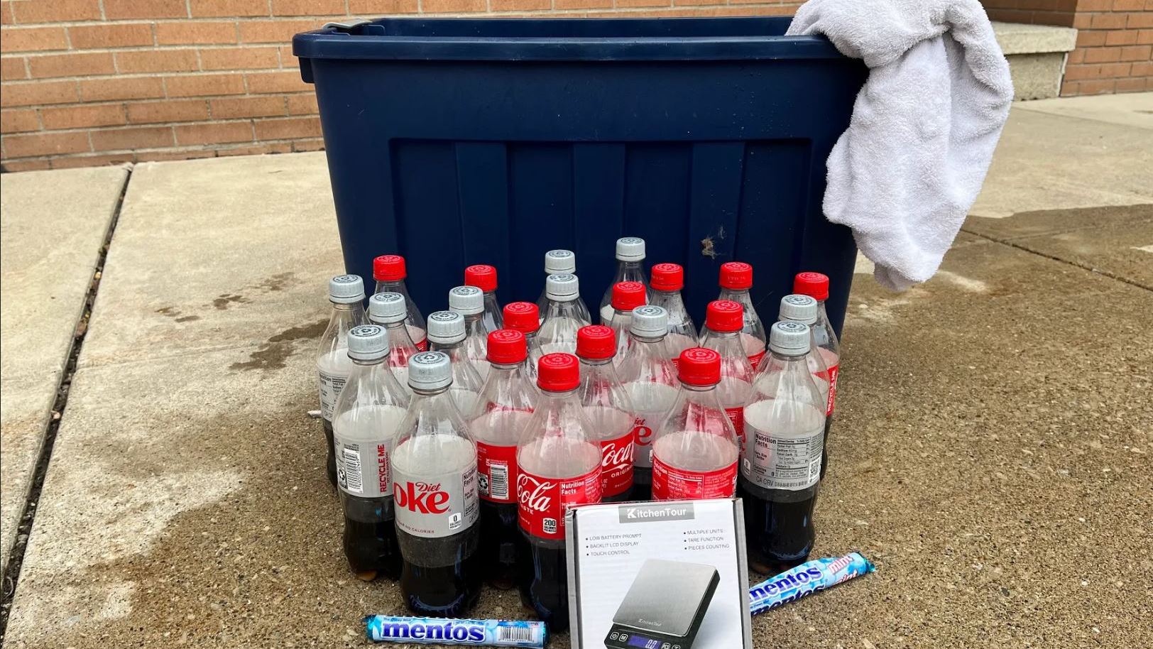
Q&A

